Slide 1
ATS Basics
Basic Introduction to Apache Traffic Server

Slide 2
What is ATS ?
Apache Traffic Server™ is a high-performance web proxy cache that improves network efficiency and performance by caching frequently-accessed information at the edge of the network.
This brings content physically closer to end users, while enabling faster delivery and reduced bandwidth use.

Slide 3
Who uses ATS ?
Traffic Server is designed to improve content delivery for enterprises, Internet service providers (ISPs), backbone providers, and large intranets by maximizing existing and available bandwidth.
We are using ATS to provide caching service for our clients for example merolagani’s subdomain (images.merolagani.com) .

Slide 4
Why ATS?
ATS is open source.
Cheaper than Varnish.
The traffic-server channel on the Apache Software Foundation Slack is the official live chat resource for the Traffic Server project, and boasts active discussions.

Slide 5
Terminology
Origin server : The server which generates the content you wish to proxy (and optionally cache) with Traffic Server.
Reverse Proxy: A reverse proxy appears to outside users as if it were the origin server, though it does not generate the content itself.
Forward Proxy: A forward proxy brokers access to external resources, intercepting all matching outbound traffic from a network.
Transparent Proxy: A transparent proxy may be either a reverse or forward proxy (though nearly all reverse proxies are deployed transparently), the defining feature being the use of network routing to send requests through the proxy without any need for clients to configure themselves to do so, and often without the ability for those clients to bypass the proxy.

Slide 6
Installation
Ubuntu -> sudo apt-get install trafficserver
Centos -> sudo yum install trafficserver
This will install the traffic server and you are ready to use .

Slide 7
What if you want to modify the ATS ?
Build from source.
Advantages of building from source is the type of plugin you want to install can be defined.
You can modify the location of the ATS.
You can use Lua Programming language to modify the requests and responses.
You can build your own plugins to modify the ATS.

Slide 8
Traffic Server Cache
The Traffic Server cache consists of a high-speed object database called the object store.
The object store indexes objects according to URLs and associated headers.
The object store can cache alternate versions of the same object
When the cache is full, Traffic Server removes stale data to ensure that the most requested objects are readily available and fresh.

Slide 9
Caching HTTP objects
When Traffic Server receives a request for a web object that is not in the cache, it retrieves the object from the origin server and serves it to the client.
At the same time, Traffic Server checks if the object is cacheable before storing it in its cache to serve future requests.
Traffic Server responds to caching directives from clients and origin servers, as well as directives you specify through configuration options and files.

Slide 10
Client Directives
By default, Traffic Server does not cache objects with the following request headers:
Authorization, Cache-Control: no-store, Cache-Control: no-cache, Cookie(for text objects)
But these are modifiable

Slide 11
Origin Server Directives
By default Traffic Server does not cache objects with the following
Cache-Control: no –store , Cache-Control:private , www-authenticate,set-cookie, Cache-control:no-cache, Expires with value of 0 or past-date.

Slide 12
In case any Disk Fails
If the disk fails completely, then Traffic Server marks the entire disk as corrupt and continues to use remaining disks.
If all of the cache disks fail, then Traffic Server switches to proxy-only mode.

Slide 13
RAM Cache
Traffic Server maintains a small RAM cache that contains extremely popular objects.
This RAM cache serves the most popular objects as fast as possible and reduces load on disks, especially during temporary traffic peaks. You can configure the RAM cache size to suit your needs.

Slide 14
Traffic Server Processes
The traffic_server process is the transaction processing engine of Traffic Server. It is responsible for accepting connections, processing protocol requests, and serving documents from the cache or origin server.
The traffic_manager process is the command and control facility of the Traffic Server, responsible for launching, monitoring, and reconfiguring the traffic_server process. The traffic_manager process is also responsible for the proxy autoconfiguration port, the statistics interface.

Slide 15
Administrative Tools
The traffic_ctl command-line interface is a text-based interface from which you can monitor Traffic Server performance and network traffic, as well as configure the Traffic Server system.
Various configuration files enable you to configure Traffic Server through a simple file-editing and signal-handling interface. Any changes you make through traffic_ctl are automatically made to the configuration files as well.(See More Detail in configuration files)

Slide 16
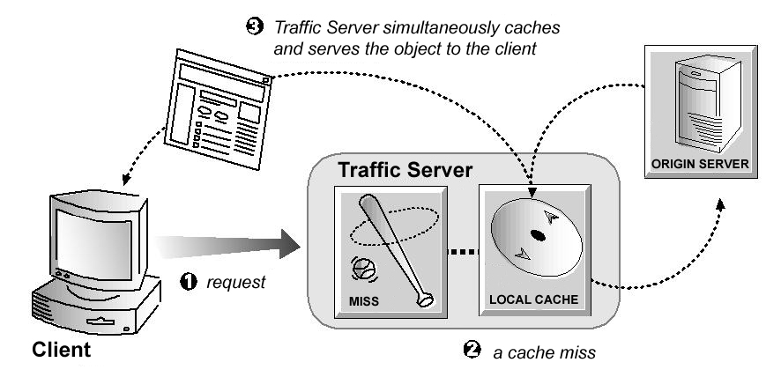
Understanding HTTP Web Proxy Caching
A caching server must act as a web proxy server to serve requests.
A web proxy server either serves the requests or forward it to the origin server.

Slide 17
Traffic Server Request Flow
Traffic Server receives a client request for a web object.
Using the object address, Traffic Server tries to locate the requested object in its object database (cache).
If the object is in the cache, then Traffic Server checks to see if the object is fresh enough to serve. If it is fresh, then Traffic Server serves it to the client as a cache hit (see the figure below).
If the data in the cache is stale, then Traffic Server connects to the origin server and checks if the object is still fresh (a revalidation). If it is, then Traffic Server immediately sends the cached copy to the client.
If the object is not in the cache (a cache miss) or if the server indicates the cached copy is no longer valid, then Traffic Server obtains the object from the origin server. The object is then simultaneously streamed to the client and the Traffic Server local cache (see the figure below). Subsequent requests for the object can be served faster because the object is retrieved directly from cache.

Slide 18
Ensuring Cached Object Freshness
When Traffic Server receives a request for a web object, it first tries to locate the requested object in its cache. If the object is in cache, then Traffic Server checks to see if the object is fresh enough to serve.
For HTTP objects, Traffic Server supports optional author-specified expiration dates. Traffic Server adheres to these expiration dates;
Checks Expires or max-age header
Checks the Last-Modified / Date header (freshness_limit= (date-last_modified)*0.10(can be specified)
Checks the absolute freshness limit(Can be specified)
Checks revalidation rule in cache.config(for eg. Dest_domain=mydomain.com revalidated=1h)

Slide 19
Configuration files
There are certain configuration files that you need to know to modify the workings of the ATS. Some important ones are listed below.
records.config
remap.config
storage.config
volume.config
ssl_multicert.config

Slide 20
records.config

Slide 21
remap.config
Defines the mapping rules
After you modify remap.config run traffic_ctl config reload to apply changes
Any syntax error will prevent an update
Each line in remap.config file must contain a mapping rule.
Format -> type target replacement
Example map https://images.merolagani.com http://113.122.115.12

Slide 22
Types of remap
map : translates incoming request URL to origin server url
map_with_recv_port: translates with port
reverse_map : Translates the URL in origin server redirect responses to point to traffic server.
redirect : redirect permanent(updates bookmark in browsers)
redirect_temporary: temporarily redirect(307 response)

Slide 23
Target (from)
Scheme://host:port/path_prefix
http://images.merolagani.com

Slide 24
Replacement
Scheme://host:port/path_prefix
Example: https://103.194.211.21/
Scheme is http, https, ws or wss

Slide 25
Precedence
map_with_recv_port and regex_map_with_recv_port
Map and regex_map and reverse_map
Redirect and redirect_temporary
Regex_redirect and regex_redirect_temporary

Slide 26
Examples
map / http://all.exampleorigin.com
map http://www.x.com/ http://server.hoster.com/
reverse_map http://server.hoster.com/ http://www.x.com/

Slide 27
storage.config
This configuration files includes all the files, directories and/or hard disk partitions that make up Apache Traffic Server cache.
After modification of storage.config new settings will be implemented only after ATS restart.
Format : pathname size [ volume = number] [id = string]
pathname is the name of the partition , directory or file.
size is the size of the named partition
Volume number is the used in the file volume.config

Slide 28
Storage.config(cont…)
Our Current Configuration is /home/tserver 500G volume=1
This assures that we assign a cache storage of 500G to ATS.
Do not use LVM for storage because it is not supported in ATS.

Slide 29
Logs
Traffic Server records information about every transaction (or request) it processes and every error it detects in log files.
By analyzing the log files, you can determine how many people use the Traffic Server cache, how much information each person requested, what pages are most popular, and so on.
Enabling Logs : proxy.config.log.logging_enabled

Slide 30
Log Types
System Logs: System log files record system information, including messages about the state of Traffic Server and any errors or warnings it produces. Its location is /var/log/messages . It is the first place you want to see if any error has occurred.
Error Logs: Error log files record information about why a particular transaction was in error.
Event Logs: Event log files (also called access logs) record information about the state of each transaction Traffic Server processes and form the true bulk of logging output in Traffic Server installations.

Slide 31
Logging.yaml
This file enables us to configure the summary logs
defines all custom log file formats, filters, and processing options.
This has 3 parts a format, a filter and the log file
Format: A format defines how log lines will appear (as well as whether the logs using the format will be event logs or summary logs).
Filter: A filter defines what events do, and what events don’t, make it into the logs employing the filter.
Log File : A log file defines where the record of events or summaries ends up.

Slide 32
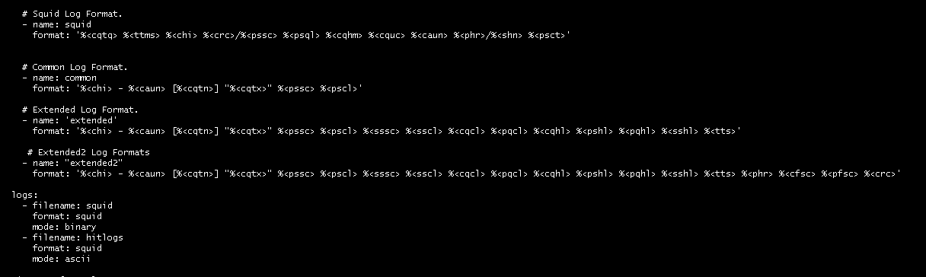

Slide 33
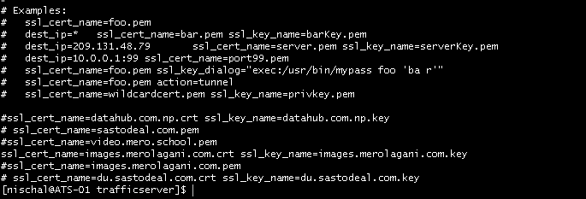
SSL
ssl_multicert.config file lets you configure Traffic Server to use multiple SSL server certificates to terminate the SSL sessions.
Changes to ssl_multicert.config can be applied by running traffic_ctl config reload

Slide 34
Cache Layout
Span : Each line in storage.config which is treated as a uniform persistent store.
The storage is organized into a set of administrative units which are called cache volumes.
Each cache volume is spread across all the cache spans for robustness.
The intersection of cache volume and cache span is cache stripe.

Slide 35
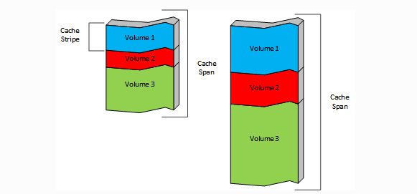
Cache Stripe

Slide 36
Cache Stripe
Cache stripe are fundamental unit of cache for the implementation.
A cached object is stored entirely in a single stripe and therefore in a single span.
The layout and structure of cache spans, the cache volumes and cache stripes are recomputed from scratch when the traffic_server is restarted.
Any changes to storage.config or cache.config will invalidate the existing cache in its entirety.

Slide 37
Span Structure
Each span is marked at the front with a span header of type DiskHeader.
Each span is divided into span blocks (similar to normal disk-partitions).
Span blocks can vary in size subject only to being multiple of volume block size which is currently 128 MB.
A cache stripe is structured data contained in a span block and always occupies the entire span block.
Internally each cache stripe is treated almost entirely independently.

Slide 38
Cache Directory
Content in a stripe is tracked via a directory.
Each element in the directory is a directory entry.
Each entry refers to a contigious storage in the cache.
The directory is treated as a hash with the cache ID as the key.
Cache ID is computed from cache key which is the url by default.
This directory is memory resident (i.e it lives in RAM so cache misses do not need Disk I/O).
The directory is always fully sized, once a stripe is initialized the directory size is fixed and never changes.

Slide 39
Performance Tuning
Hardware Tuning(efficient allocation of hardware)
CPU Selection(Multicore processors and architecture)
Memory Allocation (10 MB of RAM For every GB of cache storage) to maintain cache directory.

Slide 40
Important Configurations
CONFIG proxy.config.http.cache.http INT 1 -> Enabled caching of proxied HTTP requests.
CONFIG proxy.config.reverse_proxy.enabled INT 1 -> Enables reverse proxy
CONFIG proxy.config.url_remap.remap_required INT 1-> enables requirement of remap rule.
CONFIG proxy.config.url_remap.pristine_host_hdr INT 1
CONFIG proxy.config.http.server_ports STRING 8080 8080:ipv6-> enables port

Slide 41
Important configuration
CONFIG proxy.config.http_ui_enabled INT 1 -> enables the UI to see
http://ats2.datahub.com.np/myCI/lookup_regex_form
CONFIG proxy.config.diags.debug.enabled INT 1 sets the log level to diagnostic or debug.
CONFIG proxy.config.diags.debug.tags STRING http|dns enables traffic.out

